Slide 1
Supporting Students with Disabilities
Notes:
Purpose
This workshop is intended to meet the following goals:
Give staff and faculty an opportunity to discuss their experiences in supporting students with disabilities
Provide staff and faculty with exposure to the College’s goal of providing an inclusive campus environment for all students including those with disabilities
Give staff and faculty a sense of the types of barriers that students with disabilities may experience in their learning through both experiential exercises, information, and discussion.
Provide a sense of the approaches that are available to minimize or eliminate these barriers
To provide an introduction or reminder of how the accommodation process works at the College
Presentation Format Options
This workshop has been presented in two different ways, depending on the audience and their needs. Option 1 focuses more on presentation of content while option 2 focuses more on dialogue and an opportunity to discuss issues, questions or concerns. You can consider which approach will work best for your presentation.
Option 1: Presentation format
Present the workshop as outlined in the PowerPoint presentation and facilitator notes below, providing opportunities for discussion as shown in the workshop outline that follows. This format is helpful when participants are looking for a broad overview on supporting students with disabilities, and in cases where this information may be new to many of the participants.
Option 2: Discussion Format
Begin the workshop with an introduction of the topics covered in the workshop (Slide 1 & 2) and follow with a broad discussion question such as:
“What issues are top of mind for you in supporting students with disabilities in your classes?”
OR
“What has your experience been in supporting students with disabilities at the college? And what issues are you working with related to this?”
Invite dialogue, sharing of experiences, and discussion of participant questions. If time permits expand on areas covered in the workshop that you feel were missed in the discussion or that would be of particular interest to the group given your discussion with them. You can also ask participants what they would like to focus on for the remaining time. We found that many topics presented in the workshop also came forward through the discussion.
Workshop Content by Slide
This Slide :
Supporting students with disabilities in BC post-secondary
Development of this course was funded by the Ministry of Advanced Education, and was a joint project between Selkirk College, the Justice Institute, and Comuson College. Each institution also pursued independent projects. You will see one of Selkirk College’s project later in this workshop.
This project began with a research phase where the three institutions sought feedback from faculty and students on their experience in supporting students with disabities’ learning and their experience accessing these supports, respectively
Two main findings from faculty were that faculty shared that they would like to have more tools and information available on how to support students with disabilities effectively, and that they found it problematic when students did not disclose their disability until late in the term.
In response to these findings, the 3 institutions have developed this workshop series to provide additional information and tools to instructors in supporting students with disabilities.
The workshops are structured so that they can be offered on-line, face-to-face, or in a blended format.
In addition, the structure allows all workshops to stand on their own, so that schools can choose the topic areas of most interest or relevance to them.

Slide 2
Introduction
Supporting Inclusive and Welcoming learning environment
Possible challenges and accommodations
College Resources
1) Understanding Disabilities
Disabilities Defined
People with Disabilities in Post Secondary and the Workforce
2) Reasonable Accommodations
Duty to Accommodate
Student/Instructor responsibilities
Lessons
&
Topics
3) Instructor Toolkit
Practical tools for assessing the accessibility of your classroom
Universal Design for Learning (UDL)
4) Working Together
Creating Inclusive Campuses
Notes:
An outline of the five workshops offered
The workshop series consists of five workshops as follows …

Slide 3
What has been your experience in teaching students with disabilities?
Successes? Challenges?
What would you like to learn more about?
Notes:
Share your experiences
Invite participants to:
share their experiences in teaching students with disabilities, their challenges and successes?
ask them what they would like to learn more about
The goal of this exercise is to help you understand your audience. If you are working with a large group, please break out into smaller groups, give the class a few minutes to reflect on these questions and share out as a class.
You can now tailor the workshop to focus more on the areas of interest to participants. You can also let them know about other workshops in the series that would be a good fit, and remind them that they can request these or complete these workshops on-line.

Slide 4
Introduction
A 30-40 minute introductory workshop intended to provide resources and information to help you in supporting the learning of students with disabilities in the classroom. Topics covered in this workshop are expanded on in four subsequent lessons.
Notes:
Introductory workshop outline
This is a 45 minute – 1 hour introductory workshop intended to provide resources and information to help you in supporting the learning of students with disabilities in your classroom.
Topics covered in this workshop are expanded on in four subsequent workshops in this series.
Outline follows on slide ...

Slide 5
What do we mean by “Disability”?
A physical or mental disability related to seeing, hearing, mobility, flexibility, dexterity, pain, learning, development, psychological/mental disorders or memory (Statistics Canada, 2014).
A study examining employment in Canada found that the percentage of university graduates with a disability and those without a disability who were employed professionally was the same
million adult Canadians being limited in their daily activities
of Canadians 15 years or older reported having a disability
Number of students with disabilities attending postsecondary institutions in Canada has steadily increased….
On average, of student population in some institutions
Silver King Campus, 2016
Selkirk College has seen an annual increase of each year over the past six years
3.8
14%
6%
20% of total
10%
People with disabilities represent the largest minority group in Canada, and the only minority group that any of us can become a member of at any time.
Notes:
What do we mean by disability?
Provides a definition of what is considered as a disability according to Statistics Canada
Provides some context for this group of Canadians including the proportion in the general population and a sense of their employment outcomes. Studies have shown that educational attainment has a positive impact on people with disabilities' employment outcomes. Most students with disabilities attending PSE have a goal of attaining employment.
Also provides context for students with disabilities in postsecondary today. Nationally, and at Selkirk College, students with disabilities form a significant proportion of the student population and this has been increasing year over year at Selkirk College.
Ask participants what they think the proportion of students with disabilities is on their campus, then provide the actual number in 2016:
Silver King campus:
KSA & Tenth Street campus:
Castlegar campus:
These numbers reflect those students with disabilities who choose to disclose that they have a disability. There are also students who may have a disability but choose not to disclose or access services, so the numbers above are likely an under-representation of the total number of students with disabilities attending PSE.
People with disabilities are the largest minority group in Canada and the only one that any of us can become a member of at any time.

Slide 6
All students have varied educational backgrounds and life experiences, interests and learning preferences.
Students with Disabilities have, in addition, the impact of their disability.
Resulting in great diversity among these students as well as great diversity in how they will approach their learning.
Notes:
Recognizing great diversity among students with disabilities
It is important to remember that students with disabilities come to our schools from a variety of backgrounds, both educational and personal. They have their individual interests, goals, personalities, and the way they approach learning. Along with this, they also experience the impact of their disability.
Put together, these intersection create great diversity among these students and great diversity in how they will approach their learning.
You will likely work with a variety of students with disabilities in your classroom. These could include:
students with chronic health conditions who may experience mobility limitations, chronic pain, or increased fatigue;
students with learning disabilities who may have difficulty in processing certain types of information;
students with mental health conditions who may have difficulty maintaining concentration and focus in classroom settings, or
students with sensory limitations affecting vision or hearing.

Slide 7
What I Wish My Instructors Knew
https://vimeo.com/163744795
Notes:
This video was created with Selkirk College students as part of the same Ministry funding as these workshops. In this video Selkirk students on the Nelson campuses share their experience at the College and what they found helpful from their instructors.
Debrief: Ask participants for their comments after listening to these students
Highlight the importance of instructor empathy and openness in these students’ experience
Highlight that these students are advising their fellow students to share their situation with their instructors so that they can be understood and can get the support they need to succeed.

Slide 8
Accommodation Process at Selkirk -a collaborative process-
Student Responsibilities
Self advocacy
Instructor Responsibilities
Support student learning & maintain confidentiality
Disability Service Coordinator Responsibilities
Support student, faculty and staff
Notes:
Accommodation process at Selkirk College
Many participants have asked questions about the accommodation process and how it works. Thus we have placed this section close to the beginning of this workshop and prior to the facilitator asking participants to share their experiences
Providing an inclusive and accessible learning environment for students with disabilities at Selkirk College is a shared responsibility and a collaborative process that involves the student, Disability Services, and instructors working together throughout the students program.
Major Responsibilities of each party are as follows:
Student Responsibilities (characterized by self advocacy)
Provide appropriate documentation to Disability Services
Request accommodations in a timely manner
Inform Disability Services and/or instructors when disability-related problems arise in a timely manner
Instructor Responsibilities (characterized by supporting student learning & maintaining confidentiality)
Review accommodation forms from students carefully
Bring any concerns regarding recommended accommodations to Disability Coordinator at the start of the term
Provide exams and related information to Disability Services staff in a timely manner
Talk with Disability Service Coordinator as soon as possible if students with disabilities are struggling to help ensure a proactive approach
Assist in implementing accommodations as required
Disability Service Coordinator Responsibilities (characterized by supporting student, faculty, and staff in working to create inclusive campuses)
Review documentation of disability
Determine reasonable accommodations
Provide Accommodation form to student
Assist in implementing academic accommodations and supports
Provide consultation and support in collaboration with other college staff in implementing accommodations
Provide support and guidance in working through disability-related challenges collaboratively with students, faculty, and staff

Slide 9
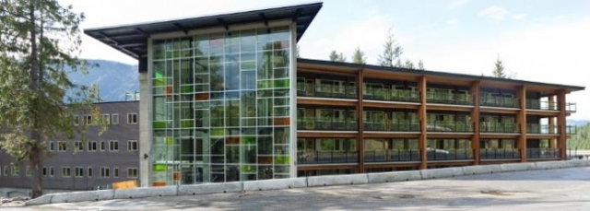
Why an Accessible Campus?
Duty To Accommodate
Reasonable accommodation by removing environmental and attitudinal barriers to their full participation.
We want to provide and effective learning environment where all students feel welcome, can access learning and can show what they know. A campus environment where students feel comfortable being themselves and where they feel that their instructors and college staff are there to help them learn – providing an inclusive campus.
Students with disabilities have the capacity and motivation to succeed but may need to pursue their studies in somewhat modified ways, or may need to access particular supports in order to remove barriers to their learning.
Notes:
All postsecondary institutions in Canada have a legal responsibility to ensure that students with disabilities have access to the programs and services offered at our institutions, and are welcomed as full participants in our campus communities. This is known as our duty to accommodate students with disabilities. We meet this responsibility by providing reasonable accommodation and by removing environmental and attitudinal barriers to their full participation.
These concepts are covered in more detail in Workshop 2: How to Accommodate.
In addition to these legally based responsibilities, increasingly, we are trying to find ways to support students’ learning by looking at where they are coming from so that we can provide an effective learning environment where all students feel welcome, can access learning, and can show what they know. This translates into working to create a campus environment where students feel comfortable being themselves and where they feel that their instructors and college staff are there to help them learn. With this goal in mind, providing inclusive campuses for students with disabilities focuses on considering how we can provide students with disabilities with a ‘level playing field’ in all areas of campus life. This would include:
feeling a part of the campus community,
being able to actively participate and engage in the learning activities in their program,
being able to access learning materials easily,
being able to use that knowledge in creating their own work, and
having a level playing field to demonstrate their knowledge.
These are the same things that we are offering to our students without a disability.
Students with disabilities have the capacity and motivation to succeed in their postsecondary settings but may need to pursue their studies in somewhat modified ways, or may need to access particular supports in order to remove barriers to their learning.
To explore some of the experiences of students with disabilities, we will look at three areas that often can present barriers to these students

Slide 10
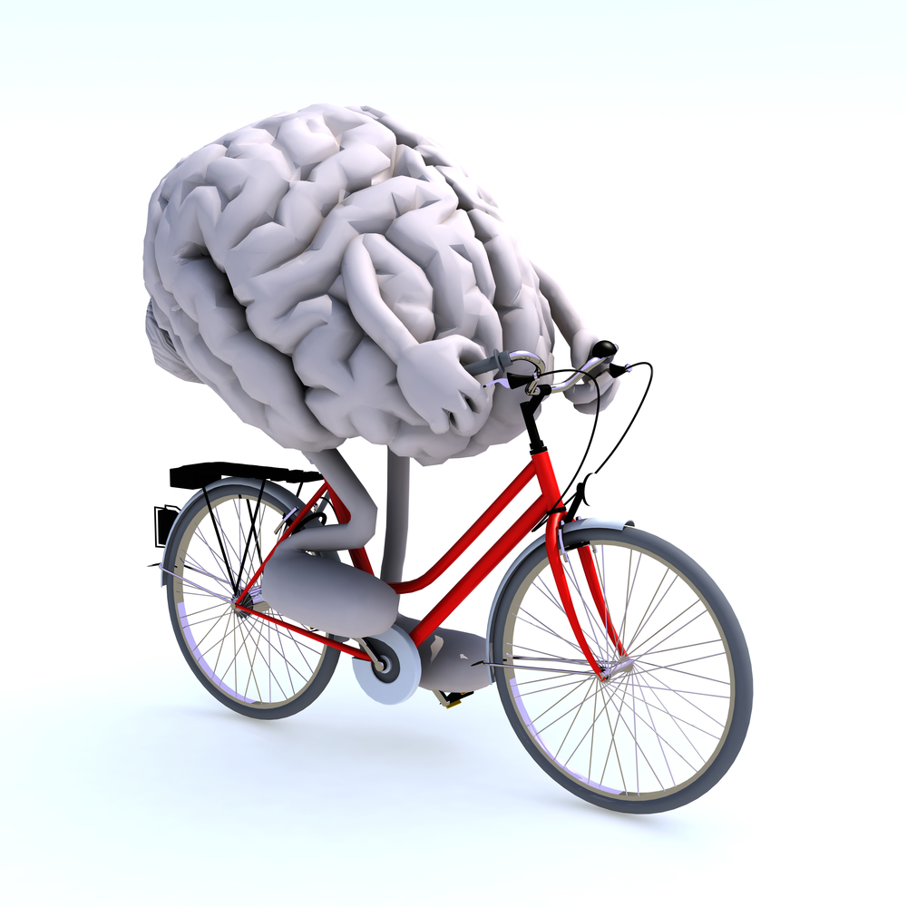
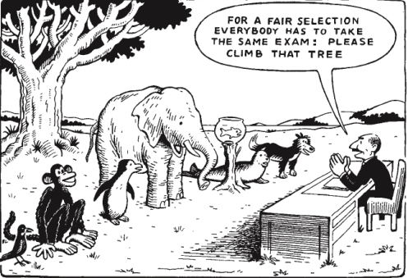
Barriers to access
1) Speed Information Processing
2) Environmental Barriers
3) Barriers During Assessment
Notes:
Barriers to Access
Speed of information processing
One of the major impacts of many disabilities on learning is that students need to take more time than the average student to process information for a variety of reasons. This impacts both the speed at which they learn and the speed at which they produce their work. For example:
Students who are blind or visually impaired will need additional time to complete readings using audio format materials or braille when compared to the reading rate of many non-disabled students.
Students with attentional difficulties may need to take more frequent breaks to help facilitate concentration when completing school work, again resulting in more time being required to complete assignments or study for exams.
Students with learning disabilities may require more time to decode written material or to proofread their work for spelling and grammatical errors.
As a result, many students with disabilities will choose to study at a somewhat reduced course load. Thus allowing them to access the additional hours they need
Environmental barriers
Other students may experience barriers in the classroom and campus environment that make learning more difficult for them.
This can include physical or sensory barriers such as not being able to access a classroom because of stairs, not being able to see material being presented due to visual limitations.
However, other environmental conditions may be less obvious. For example students may experience barriers to their learning when information is presented faster than they are able to comprehend fully as may be the case for a person with a learning disability, while a person with a mental health condition such as an anxiety disorder may find it more difficult to concentrate in a noisy high stimulation classroom.
Barriers during assessment
Students can also experience significant barriers to their ability to express their knowledge and understanding of course content to their instructor. For example:
A student with a learning disability that impacts their ability to read, especially under timed conditions, may only be able to answer half the questions on an exam even though they know the answers to remaining questions as well.
Another student who has difficulty with producing written answers may struggle to demonstrate their understanding of concepts which they would be able to explain verbally very well.

Slide 11
DIAMOND NAPKIN
It looks something like this
Example of a poor PowerPoint. Why?
https://www.youtube.com/watch?v=ApYyTBsn2K0
Notes:
Experiential Exercise
The following experiential exercises are meant to accomplish the following:
Provide opportunities for participants to experience what it could be like to have a disability
Provide participants with an opportunity to reflect on and discuss what this activity and experience felt like and how this experience could inform their understanding of students with disabilities experience
Provides an opportunity to highlight how principles of universal design could make this experience more accessible for more participants (in the diamond napkin fold activity)
This slide is an example of a POOR slide. Font is hard to read, final product does not look exactly like the goal. Such use of a PowerPoint can be confusing to certain students.

Slide 12
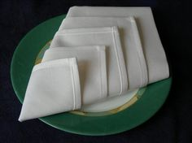
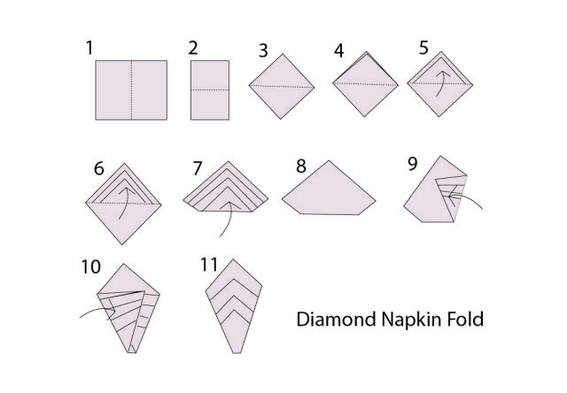
How to Make a Diamond Napkin Fold
From a square paper napkin in 11 easy steps
https://www.youtube.com/watch?v=FlHVk5gUX5c
Notes:
Diamond fold napkin activity
Materials:
Paper napkins - enough for each participant
Various props that can be used to simulate a disability. For example, safety glasses with partially or fully taped over lenses, noise cancelling earphones or disposable earplugs, bulky work gloves that limit dexterity.
Sounds track of classroom noises (link on powerpoint)
Running the Activity
Provide each participant with a napkin and pass around the box of simulation supplies asking each participant to take one or two for their use in the activity.
Ask participants to put on their chosen simulation item(s)
Start classroom noise simulation, ensuring that the volume is sufficiently high to be somewhat distracting
Start demonstrating how to accomplish the diamond napkin fold. Do not make an effort to talk over the background noise too much. Use terms like “fold like this” as opposed to describing what you are doing. Do not make an effort to go particularly slowly through the exercise, or to repeat steps if participants are struggling. End the exercise by holding up the completed napkin to show what the participants have been expected to accomplish.
Is this a better use of the PowerPoint? Why? (Font, diagram, listing number of steps, representative photo, better link that students could refer back to…)
Debrief
Ask participants how it felt to participate in the exercise
Debrief continued - Application of Universal Design for Learning (UDL) to the Diamond Napkin fold
Describe how Universal Design principles could be used to make this activity more accessible for more participants by:
having a detailed step-by-step picture
showing a video of how to do the napkin fold
Having both the step-by-step instructions and video available on the class website for later viewing
Using more descriptive language to explain the steps verbally (replacing the “fold like this”
Providing a quieter environment where participants can concentrate
Providing a slower pace and assistance for participants who are struggling

Slide 13
ORANGE
YELLOW
GREEN
BLUE
RED
Students with learning disabilities often take longer to process information because they are not able to process the information as automatically.
Processing may require more effort and concentration and may involve ‘interference’ making the requested information (colour of the word) harder to provide automatically.
Notes:
Color Activity
This activity is meant to give participants of what it could be like to have a learning disability. The activity challenges participants to divide their attention among two different pieces of information, asking them only to respond with one, and to ignore the other. The activity starts as easy and becomes progressively more difficult.
Materials
Use Slide 13. However, display only one line of figures at a time, so that participants do not see the line(s) below the one they are working on.
Running the Activity
Call on individual participants to name the color of the puzzle pieces such as “red”
Next bring up the colored objects. Again ask different individuals to name the color of each object.
Finally, bring up the line of colored words. Ask other individuals (and perhaps ask some of hte same ones again) to tell you the color of the word, NOT what the word says.
Usually participants will have more trouble with the last line because it will be harder to separate reading the word from saying the color (which are different).
As you run the exercise, go through the items fairly quickly. This usually won’t be a problem until the last line.
Debrief
Ask participants how they found this exercise
This exercise simulates what it could be like to have a learning disability. Students with learning disabilities often take longer to process information because they are not able to process the information as automatically as those without a learning disability. As a result, processing may require more effort and concentration to accomplish. This exercise gave you an opportunity to experience ‘interference’ between two types of information, making the requested information (colour of the word) harder to provide automatically.

Slide 14
Given your experience with the experiential exercises earlier, what are your impressions of what attending college as a student with a disability could be like for a student attending your program? What do you think would be the most challenging?
Nick’s experience with Dyslexia:
http://www2.unb.ca/alc/modules/learning-disabilities/video.html
Notes:
Discussion Question - Experiential Activity
This debrief question is meant to give participants a chance to reflect on their experience with the last two activities, and to link this to what students with disabilities in their programs could experience. Thinking empathetically about these student’s experience.
Given your experience with these activities, what are your impressions of what attending college as a student with a disability could be like for a student attending your program? What do you think would be the biggest challenge?
Show Nick’s video on his experience with Dyslexia. Following the video, ask if anyone has additional comments to add. If not, note that Nick’s experience and needs for some adjustments is very typical. With these adjustments, he is able to succeed.

Slide 15
Supporting Inclusive & Welcoming Campuses
If these students need things done somewhat differently from the norm, how can we get this done since our schools are set up for the ‘average’ student?
Reasonable Accommodations:
academic accommodations and supports that help to remove barriers and level the playing field.
2) Universal Design for Learning:
changing the ways things are done for all students to better meet the needs of diverse learners.
Notes:
The question then becomes, “if these students need things done somewhat differently from the norm, how can we get this done since our schools are set up for the ‘average’ student?”
Two approaches can be used, and both approaches help to enhance the accessibility and inclusiveness of our programs and campuses.
Reasonable Academic Accommodation
The first involves putting into place academic accommodations and supports that help to remove barriers and level the playing field for individual students with disabilities. These changes to regular practice are made based on documentation of a student’s disability and so are individual arrangements for a particular student. Examples include additional time to write exams, permission to record lectures or assistance in accessing specialized technology.
Reasonable accommodations meet the following criteria:
Accommodations are based on documented individual needs.
Allows most integrated experience possible.
Do not compromise essential requirements of a course or program.
Do not pose a threat to personal or public safety.
Do not impose an undue hardship or administrative burden.
Accommodations are not of a personal nature.
The second approach is:
Universal Design for Learning
A second approach involves changing the ways things are done for all students to better meet the needs of diverse learners, and is referred to as Universal Design for Learning (UDL).
UDL works from the recognition that the ways in which students acquire knowledge best and express what they know effectively, can be very different from student to student. As a result learning and assessment can be more effective when this diversity is recognized.
Options include:
presenting material through a range of mediums (lecture, videos that can be viewed later at a student’s own pace, sharing of class notes, etc)
providing various options for expressing and assessing student knowledge and understanding (providing option for take-home paper/exam or in-class exam)
various approaches to promote student engagement and motivation (giving students a choice to participate in class discussions and/or on-line discussions)
All these approaches are examples of recognizing the diversity of learning styles and abilities found in every class

Slide 16
Interacting with Students with Disabilities
Recognize that students with disabilities, even with the same disability, are not alike. Treat each student as an individual.
2. Related to this, if you think that something may be helpful for a particular student with a disability, ask, but respect their choice if this is not the case.
3. Try to see the student’s perspective on the situation at hand remembering that their experience of the world is different than yours – ie. empathy, what is it like in their shoes?
4. Recognize that you don’t need to have all the answers, that the student will likely have some, and that other campus resources such as the Disability Services Office may be able to help with ideas also. This is a collaborative effort.
Notes:
Interacting with Students with Disabilities
These five Tips are meant to convey the importance of:
Respect
Importance of treating each person as an individual
That working to have empathy for those with a different lived experience from our own, can make a very big difference in students with disabilities’ experience in your class (seeking understanding)
Recognizing that instructors are not alone in working to improve the learning experience of students with disabilities - support and a team-based approach is the norm here

Slide 17
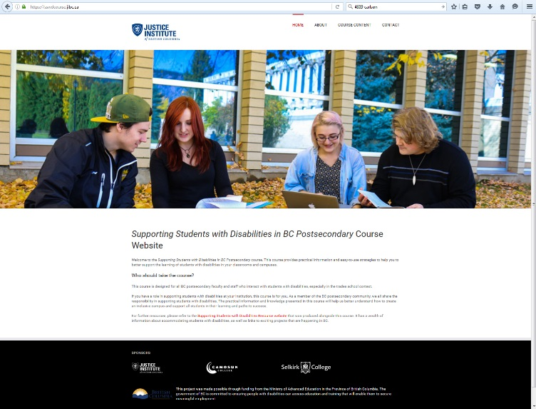
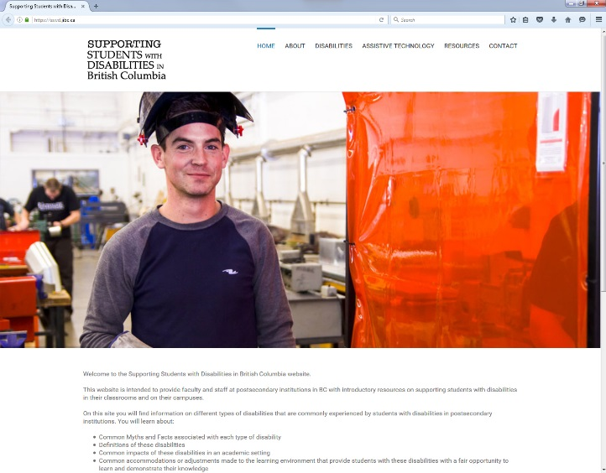
Additional Resources
Possible future workshops:
Understanding Disabilities
Reasonable Accommodation
Instructor Toolkit
Working Together
Disability Coordinators
Castlegar – Trish Foy
Nelson – Myriam Spencer
Also found online
Students With Disabilities Resource Site
https://sswdcourse.jibc.ca/
https://sswd.jibc.ca/
Notes:
Further workshops & resources
Reminder of other workshops available, as well as other resources including the on-line version of the workshops, the Disabilities Resource site, and Disability Coordinators on the Nelson and Castlegar campuses.

