Slide 1
Working Together WORKSHOP 4
Notes:
By the end of this lesson you will be able to:
Build empathy for the different lived realities of students with disabilities in postsecondary education and how to support these students’ learning and development, and achievement of their goals
Discuss institution-wide responsibilities for providing a welcoming environment for SWD
Reference the strategic plan for your own institutions and what it says about inclusion
Identify personal goals to meet individual students needs and/or create an inclusive learning environment
Consider what resources and supports you you need to move forward

Slide 2
Course Objectives
This lesson will introduce a team-based approach to supporting students with disabilities. It will also give opportunities to reflect on the services for students with disabilities in your institution and in your classroom. Finally, it will help to identify some ‘next steps’ that institutions and instructors can take to make learning more accessible.
Notes:
Course Outline
Describes what will be covered in the workshop.

Slide 3
In this workshop we will:
Consider what is involved in working towards and realizing an accessible classroom & campus
Hear about student perspectives on what is most important for them, and see an example of what a strong commitment to access can look like
Think about your own goals & what you would need to make them happen
Notes:
Course Outline
Describes what will be covered in the workshop.

Slide 4
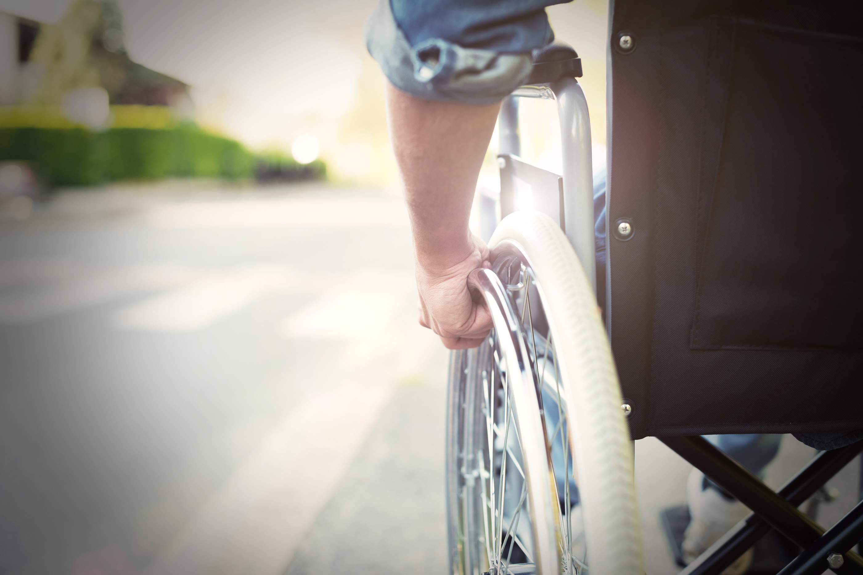
Creating Inclusive Campuses
How does it feel to be a student with a disability in your institution?
Notes:
We can never know exactly how it feels to walk in another person’s shoes, but we can develop empathy for the challenges faced by students with disabilities. Research studies have shown that the way that instructors interact with students and their attitude towards students with diverse needs, has more impact than any other accommodation or support (Orr, 2009). Instructors play a major role just by being approachable, keeping an open dialogue and creating a safe and respectful environment.

Slide 5
What I Wish My Instructors Knew
https://vimeo.com/163744795
As you watch the video, think about the following questions:
What meant the most to these students in terms of their interactions with their instructors?
What did you learn from their reflections & experience?
Notes:
In this video, a student reflects on their experiences in post-secondary education and talks about the things they wish their instructor knew.

Slide 6
What does an inclusive campus look like?
A safe, respectful environment where diverse students feel welcome.
Academic accommodations and supports that help to level the playing field for students with disabilities.
Creating inclusive learning environments and campus communities.
Staff and students use a team-based approach with ongoing communication and collaboration.
Notes:
There is not one, easy answer to this question, as each campus is unique, just as each student is unique. Institutions will always be evolving and trying new methods as they try to improve their practice. However, there are several key characteristics that help a campus to be as inclusive as possible for students with different learning needs.
A safe, respectful environment where diverse students feel welcome. An environment where students feel comfortable being themselves and where they feel that their instructors and college staff are there to help them learn. This can be achieved through open lines of communication between staff and students, both in person and online. Staff hold high expectations for all students, including students with disabilities, and work together to meet the diverse needs of students.
Academic accommodations and supports that help to level the playing field for students with disabilities. Instructors and the Disability Services Office work together to provide accommodations, based on the documented needs of students. These accommodations do not change any of the essential requirements of the program, but remove barriers to learning.
Creating inclusive learning environments and campus communities. The campus environment and the courses offered are designed from the outset to be accessible to as many people as possible. The physical space is accessible to people in wheelchairs and with visual impairments. Courses offer flexibility and choice, so that all students can learn and demonstrate their knowledge in different ways. Online learning environments are accessible to students who use assistive technology or have hearing impairments.
Staff and students use a team-based approach with ongoing communication and collaboration. Students feel confident discussing their learning needs as soon as they enter the program, rather than waiting until they are already having difficulties. Disability Services staff and Instructors work together to make sure that accommodations do not interfere with the essential learning outcomes of the course. Instructors can seek support at any time for help with assistive technology or concerns about students with disabilities in their classes.

Slide 7
An example of a college
working to be more inclusive
The college in this video is working to make sure that its online content is accessible to all students.
https://www.youtube.com/watch?v=eks3r-nE9lU
Notes:
Group Discussion Question:
What is your college doing to help create an inclusive campus?
You might consider:
Physical environment and accessibility
Accessibility of online content
Assistive technology
Individual accommodations
Universal Design for Learning
Respect and empathy for diverse learners
As a facilitator, you may wish to share your institution’s strategic plans, resources and/or tools around supporting students with disabilities at this point of the course.

Slide 8
Personal Goals & Next Steps
In this last section, you will have some time to set some personal goals and think about next steps.
You will also have an opportunity to give feedback to your institution about the information, supports and resources that you need to achieve these goals.
Notes:
As part of your college’s wider commitment to create an accessible campus, there may be steps that you can take as an instructor to support students with disabilities.

Slide 9
Personal Goals:
In order to be achievable, goals should be specific and realistic.
What are some practical changes that you would like to make in your own practice, to make your classroom as accessible as possible for all students?
Notes:
You could consider:
Ways to support accommodations for individual students
Committing to learn more about disabilities, how they can impact learning, and what tools are available to mitigate for these impacts and increase accessibility
Offering flexibility and choice so that courses are more accessible for a range of learners.

Slide 10
Next Steps:
Once you have identified some goals, think about some practical steps that you could take in order to achieve those goals. Try to put a completion date next to each step, to indicate a time when it could realistically be achieved.
Resources Needed:
Finally, think about any further information, supports or resources that you will need to achieve your goal. Where could you find these resources? What do you need from your institution or colleagues to move forward?
Notes:
Ask participants to work on the Supporting Students with Disabilities Worksheet (found in the handout) and fill out the table.
Ask participants to share their personal goals and resources needed in small groups
Save a copy of your worksheet and share it with your colleagues to discuss next steps.
Completion Date
Try to put a completion date next to each step, to indicate a time when it could realistically be achieved.

Slide 11
Thank you very much for your time and feedback
For further resources, please refer to the SSWD website that was produced alongside this course.
It has a wealth of information about accommodating students with disabilities, as well as links to exciting projects that are happening in BC.
https://sswd.jibc.ca/
Notes:
Thank you.
Comments? Thoughts? Feedback?

