Slide 1
Instructor Toolkit workshop 3
Notes:
Introduction
It can be challenging for instructors to know where to start in improving the accessibility and inclusiveness of their classrooms for students with disabilities. The aim of this workshop is to provide instructors with practical “rubber hits the road” tools for supporting students with disabilities. One of the intentions of this workshop is to demonstrate that by making learning environments more inclusive, all students will be better served – not just those with a disability. If instructors are willing to make an initial time investment, be aware and empathetic and work together, it is very likely that they will be able to deliver more effective lessons and assessments to a broader audience and everyone will benefit. This workshop helps to consider options for flexible teaching and evaluation methods that accommodate a variety of learning needs. (consider environments too)

Slide 2
Objectives
Consider how you can recognize and respond to diverse learning styles and abilities in your classroom
Apply practical tools that allow you to assess your learning environment for accessibility for a wide range of learners
Learn about Universal Design for Learning and how the principles of UDL have practical application in the classroom
Have an opportunity to discuss these approaches with fellow workshop participants
Notes:
Course Outline
This workshop will help instructors to recognize the range of learners and learning styles present in their classrooms, and consider this in relation to teaching, learning, and evaluation practices

Slide 3
Creating Inclusive Learning Environments
As adults, students have a responsibility to come forward and ask for assistance.
Instructors also have a responsibility to create an environment where a diversity of learners are valued and students feel comfortable asking for support.
Demonstrating a commitment and openness to supporting a diversity of learners can go a long way
Notes:
Creating Inclusive Environments
Not all students are willing to disclose to their instructors that they have disability-related difficulties which makes helping them difficult when an instructor is unaware of their circumstances.
Some students are experienced and confident in advocating for their learning needs, but others may be reluctant to come forward. For these students, it can be several months before their struggles come to light, and by then they may be seriously behind with their studies. Though we have no means of requiring students to come forward, we can make it easier for them to do so by creating an environment where students are more comfortable with asking for assistance. Instructors have a responsibility to create an environment where diversity of learning is accepted and students feel comfortable asking for help.

Slide 4
Creating Inclusive Learning
Environments
An inclusive environment and flexible teaching and evaluation practices can mean the difference between success and failure in a student’s chosen course.
We will:
consider an instructor’s experience
explore an assessment tool
learn about the principles of UDL
Notes:
If our goal is to create classroom environments that are inclusive and support the wide range of learners that are present in our classrooms, the questions then becomes, how do we accomplish this as instructors? We are going to look at answering this question through a few ways. First we’d like to show you a video of one instructor’s experience in working to create an inclusive classroom. Then we’d like to give you an opportunity to think about and assess the accessibility of your own classroom environment using an assessment tool, and finally, we will introduce some of the Principles of Universal Design for Learning (UDL) which can also be helpful in thinking about how you can develop your learning experiences to support all learners.

Slide 5
An Instructor’s Experience
https://sswdcourse.jibc.ca/topic/topic-1-impact-of-teaching-learning-evaluation-practices/
Consider the values this instructor brought to her approach to creating a supportive environment for students with attentional difficulties.
How could her approach help students to feel valued and comfortable in seeking support?
Notes:
This is a six minute video. Choose the length of the video that makes sense for your purposes.
Suggested points for discussion after watching:
-instructor demonstrates empathy for students situation
-willingness to explore a variety of options that will support learning
-value in accessing further information & resources to promote understanding
-recognized student’s struggles and had a focus on how to enhance their opportunity for success
-recognized that students have successful days and challenging days and stays focussed on ‘big picture’.

Slide 6
Two Tools for Moving Towards More Accessible & Inclusive Classrooms
Classroom Accessibility Checklist
Principles of Universal Design for Learning
Notes:
As mentioned earlier, it can be challenging for instructors to know where to start in improving the accessibility and inclusiveness of their classroom for students with disabilities. To help give you a starting place and some tools to work with, we will look at two approaches that can help you assess how accessible your classroom is currently and how you can begin to consider changes or enhancements that will increase access to learning for students with disabilities and all students.
You may find that one approach resonates with you more than the other, or you may find aspects of each useful. We will give you opportunities to put both approaches into practice during this workshop.

Slide 7
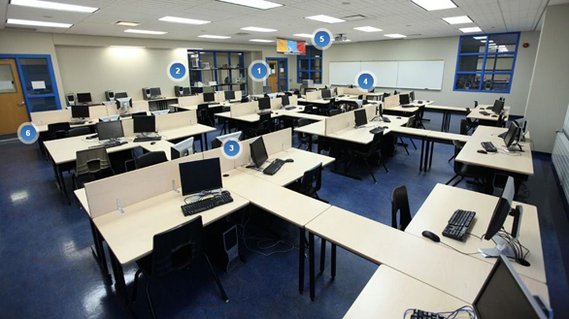
How accessible is your classroom?
Exploration of a tool that instructors can use to complete a quick assessment of five aspects of their own learning environment.
Notes:
As a starting point, it can be helpful to have a guide for considering various aspects of your learning environment.
Options for using this tool in the workshop:
-present these five elements to participants, using the checklist items (on the slide) and examples (in facilitator notes) to illustrate each element, and what an inclusive classroom could look like..
-Next, provide participants with a print out of the pdf checklist (found on course website), ask participants to choose two or three elements for discussion in small groups either drawing from their own experience or using the case study that follows.
Use this tool to identify possible barriers to learning in your classroom. What are you already doing to accommodate a variety of learning needs? What could you do in the future to improve accessibility?

Slide 8
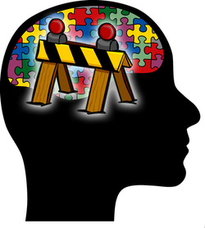
1. Attitudinal Barriers Behaviors, perceptions and assumptions that discriminate against persons with disabilities. These barriers often emerge from a lack of understanding, which can lead people to ignore, to judge, or have misconceptions about a person with a disability (Council of Ontario Universities, 2013).
Checklist:
Staff do not make assumptions about a student’s disability or capabilities
Students with disabilities can come forward and speak instructors about the way they learn and what may be “disabling” in their course, classroom or teaching.
Discriminatory language or behavior is challenged.
An inclusive environment is created, in which all students respect people’s differences
Notes:
Instructors have a strong opportunity to model positive attitudes towards diversity in their classrooms. An approach that values diversity sends a clear message to both students with a disability and to all students in the class. This approach helps to ensure that all students can see that their learning experience is valued, that they are respected, and that they are being treated as an individual with their own distinct situation and approach to learning.

Slide 9
2. Organizational barriers Policies, procedures or practices that unfairly discriminate and can prevent individuals from participating fully in a situation. Organizational or systemic barriers are often put in place unintentionally.
Checklist:
The essential course content and learning outcomes are expressed clearly
There is flexibility so that students can express their understanding of essential course content in multiple ways.
Assessments evaluate the knowledge and skills that are directly related to learning goals and instructional methods. For example, if the learning outcome is to have a knowledge of health and safety procedures, students will not be penalized for slow writing speed or incorrect spelling.
When student supports do not interfere with assessment of a learning goal, assessment arrangements provide students with those supports (e.g., text-to-speech tools for an assessment of history or science understanding, no TTS tools when assessing reading ability).
Notes:
Organizational barriers
Some of these organizational barriers are removed or mitigated for through academic accommodation. For example, a student may be provided with access to technology such as text-to-speech software for exams or an accommodation of no penalty on spelling errors may be put in place. Determining reasonable academic accommodations is the responsibility of the Disability Service Coordinator because they both have details regarding the student’s specific situation (in the student’s documentation of disability), and because they have the expertise to recommend what would be a reasonable adjustment to normal practice given this information.
There are also a range of things that you can consider as an instructor that will help remove organizational barriers and can in turn go a long way to help students with disabilities, and all students, maximize their learning. This can include being clear on core learning outcomes for your course so that all students know what to focus their efforts on; thinking about providing learning materials and delivering content in class through a variety of mediums and points of access; and considering providing a range of options around assessment instead of using only one approach.
Most institutions have limitations around funds and resources however trying to work towards removing organizational barriers can be worked towards over time. Even if all barriers cannot be immediately resolved, just being aware of them, and making realistic adjustments over time, will help create a sense of understanding.

Slide 10
3. Architectural or Physical Elements of buildings or outdoor spaces that create barriers to persons with disabilities. These barriers relate to elements such as the design of a building’s stairs or doorways, the layout of rooms, or the width of halls and sidewalks.
Checklist:
Classrooms are accessible to students with disabilities (e.g. elevators, ramps, wide corridors).
Adjustments are made to classroom elements to improve accessibility eg. llighting, such as eliminating glare by closing blinds, or seating by providing adjustable chairs to meet specific student needs.
Background noise can be limited, by turning off noise machinery or closing doors/windows.
Assistive technology is available to improve accessibility.
Different classroom location is considered to improve accessibility of class
Notes:
Architectural or physical barriers
Depending on the age of your school’s infrastructure, it can be an ongoing process to improve accessibility throughout the campus especially for buildings that were not originally constructed with accessibility in mind. In some cases physical barriers can be removed with the assistance of the Disability Service Coordinator. This can include arrangements for accessible parking, or arrangements for specialized seating in the classroom to address chronic pain issues. Many architectural barriers can be expensive to implement and so may not always be feasible. Making your Disability Services Office aware of these barriers can help start the conversation around what changes can be reasonably made. Thinking about issues of accessibility should also be part of the planning process when renovations and re-organizations are being planned.

Slide 11
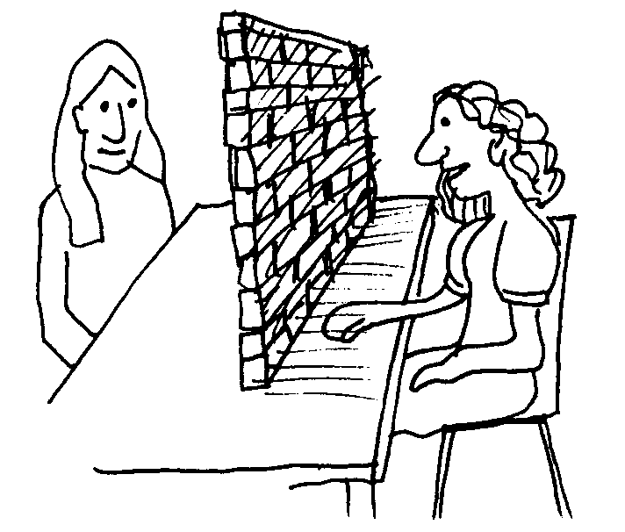
4. Information or Communications Barriers when sensory disabilities, such as hearing, seeing, or learning disabilities, have not been considered. These barriers relate to both the sending and receiving of information.
Checklist:
Lesson goals and objectives are presented in varied and flexible ways (e.g., orally, in print, in digital text with read-aloud options, and/or as a graphic).
Multiple and varied media are used to present concepts and content (e.g., text, images, graphics, audio, video, and multimedia).
Materials and media provide visual equivalents for auditory information and vice versa as needed (e.g., captions for videos, text outlines for lectures, text-to-speech or digital voice tools for text).
Students have the opportunity to practice new skills in a realistic context, through classroom demonstrations and simulations.
Critical features, big ideas, and important relationships are highlighted to guide attention and learning (e.g., concept maps, highlighted text, outlines, diagrams, multiple examples with non-examples)
On-going, relevant feedback is available to students (e.g., peer-to-peer conferencing in person and online, digital "worklogs" or portfolios with teacher/student exchange built in). Students exhibit self-monitoring skills and take advantage of ongoing, relevant feedback provided to revise their work and discuss it with peers.
Notes:
Information or communications barriers
Students with disabilities often experience difficulty in processing information in the classroom or in course materials due to the functional impacts of their disability. Some of these barriers are again addressed through academic accommodation (eg. more time for test writing). However, there are still many things that you can consider and do in your classes that can help students in a variety of situations to access information more fully. Some of the best approaches to improving information processing relate to presenting your course goals, content, key concepts, and expectations in a variety of mediums. This helps to ensure that students have the opportunity to access information in a way that is accessible to them. For example, providing your course powerpoint in advance on the course website will allow a student with a visual impairment to access this information ahead of time and to put the powerpoint on their own device so that they are aware of the visual content as it is being presented in class. This approach could also help a student with a learning disability, who needs more time to process written information, by allowing them to take time in advance of class to read the slide content at their own pace. Ensuring that you provide explanations of key concepts in a multi-modal approach, visual, oral, and in a take-away form such as a handout (for later review), is another example of recognizing a diversity of information processing needs. These approaches will help all students in your class as well since all students have certain approaches that work best for them.
In addition, course objectives should be simple and clear and feedback welcome and easy to provide.

Slide 12
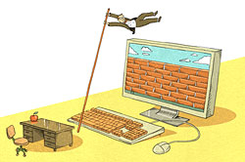
5. Technology Barriers Technology can enhance the user experience, but it can also create unintentional barriers for some users (often related to information and communications barriers).
Checklist:
Handouts and course materials are available in electronic format
Course websites and online learning environments can be accessed using screen-reading software
Technology is used to provide alternative teaching methods, through audio, visuals and web-based lessons
Technology is used to give students alternative methods to respond and demonstrate their knowledge, through text to speech software and voice recognition software
Technology aids such as spell checkers, alternative keyboards and recording devices, help students to engage more effectively in learning and increase their confidence and sense of independence
Both students and instructors receive effective training on the use of technology
Notes:
Technological Barriers
Technology barriers can occur when a device or technological platform is not accessible to its intended audience and cannot be used with an assistive device. Discussions with specific students may be required to see what actually works best for them and if they are able to access current course materials with the technology that they are using.
Sometimes the way current technology is being used can also create unintended barriers. For example, if students are not able to see the full screen during demonstrations because of classroom setup. This creates barriers for all students but can magnify existing barriers for students who are already experiencing other impacts of their disability. Working to find solutions to these issues when they are identified is important.
Technology also provides many opportunities for improving access. Taking time to consider how technology can improve accessibility by discussing with your instructional team, Disability Services staff, and IT staff, can be a good start.

Slide 13
Scenario Activity:
Dave Small is an experienced instructor in business administration. He is popular with students because his classes are full of engaging and funny stories from his experiences in the business world.
At the start of the year, Dave verbally outlines the learning goals for the course and explains how the course will be assessed. Assessment is through a written portfolio, a midterm and a final exam.
Student readings are from a core textbook. There are also additional readings, which are provided in class as photocopied papers. The majority of classes consist of lectures and student presentations. While presenting, Dave writes some notes on the whiteboard and shows some videos.
In the midterm, five students receive very poor grades. Dave cannot understand, as all of the answers to the midterm were covered in lectures and were in the textbook. He seeks advice from the Disability Services Office, as three of the five students receive accommodations because they have documented disabilities.
Notes:
Following two slides: Scenario Activity
Now that we have reviewed these five classroom elements with respect to accessibility, let’s try using the tool to assess a learning scenario.
Facilitator can use the above scenario or can ask participants to draw from their own experience to discuss and ‘try out’ this tool.
Suggestions are given on the next slide for possible approaches to the scenario presented on this slide However, this is a wonderful opportunity learn from your workshop participants by asking for their ideas and kindling an open discussion of what has worked in the past or not and the lessons learned from participants experiences. What worked? Why? What might you do differently next time?

Slide 14
Scenario Activity:
Here’s a few suggestions:
Talk to students who received poor grades and ask them why they had difficulties
Provide learning goals in a variety of formats, for example as a written document, on a course website, and through student group discussions.
Provide a variety of assessments, for example the choice to give an oral presentation, instead of a written assignment.
Provide electronic copies of handouts
Provide visuals for lectures, such as PowerPoints, that emphasize the key points
Provide opportunities in class to apply knowledge, in the form of small group work and practical simulations
Notes:
See previous slide

Slide 15
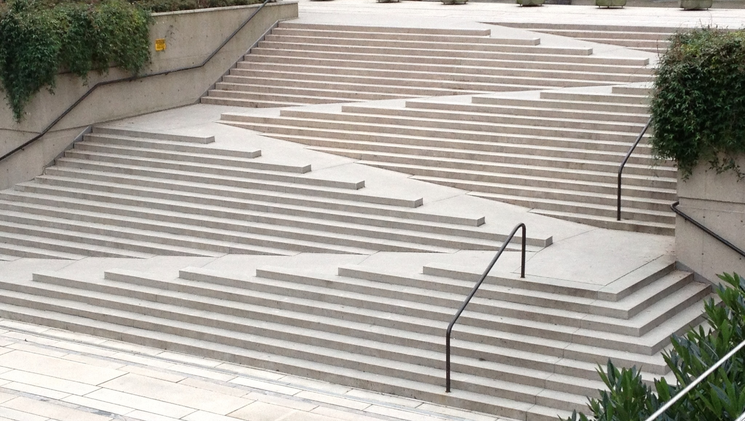
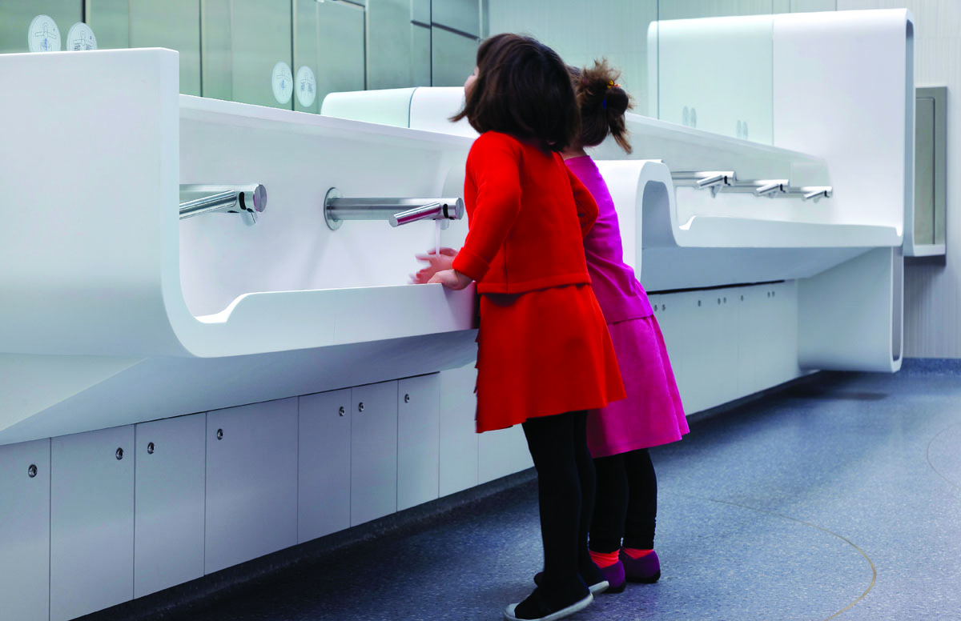
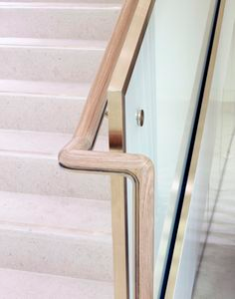
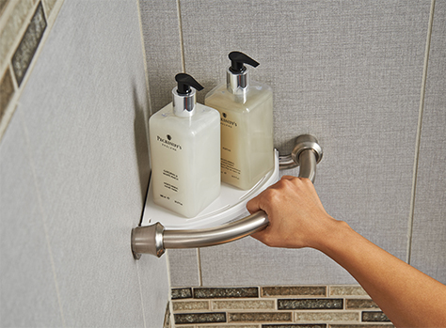
Universal Design
Universal Design for Learning originated from the ideas of universal design in architecture. In architecture, the idea is that physical environments could be designed to meet the needs of a diverse range of people with varying abilities and preferences. The outcome often is that these flexible environments not only provide benefits to those with unique characteristics or exceptional needs, but also benefit everyone.
Notes:
UDL is a framework being used in many educational institutions to help instructors and staff assess their learning environments and make improvements to increase accessibility and inclusiveness for diverse learners. An important concept to introduce here to participants is that UDL is something that, whether they realize it or not, is already gaining significant ground in society. Small changes can make a big impact to ALL students.
In architecture, this approach focuses on thinking about meeting the needs of diverse individuals during the design phase instead of trying to react to barriers or needs after the fact. The result is designs that are flexible and provide a variety of options for use. For example, an architect may consider how people who have difficulty with mobility will access a building while designing the building, providing ramps and automatic door options at various entrances for example. This provides a great benefit to these individuals but also to others such as families with strollers or delivery personnel. Also, because this access was built into the design at the start, there is no need to react to this barrier after the fact, which can be much more costly and potentially less well integrated into the building design.
In a similar way, Universal Design for Learning (UDL) provides an outline of how College & University staff and faculty can take a proactive approach to planning their courses and programs by thinking about the needs of a range of students when they are designing or modifying their courses.
In the previous section, we introduced a tool that can help you to look at how accessible your classroom and course is for diverse learners. In this section, we will talk about some of the benefits of UDL for yourself and your students, as another approach to exploring and implementing changes to improve access and inclusiveness in your classrooms. We will look at the principles behind UDL, and how you can use these principles in your course planning.

Slide 16
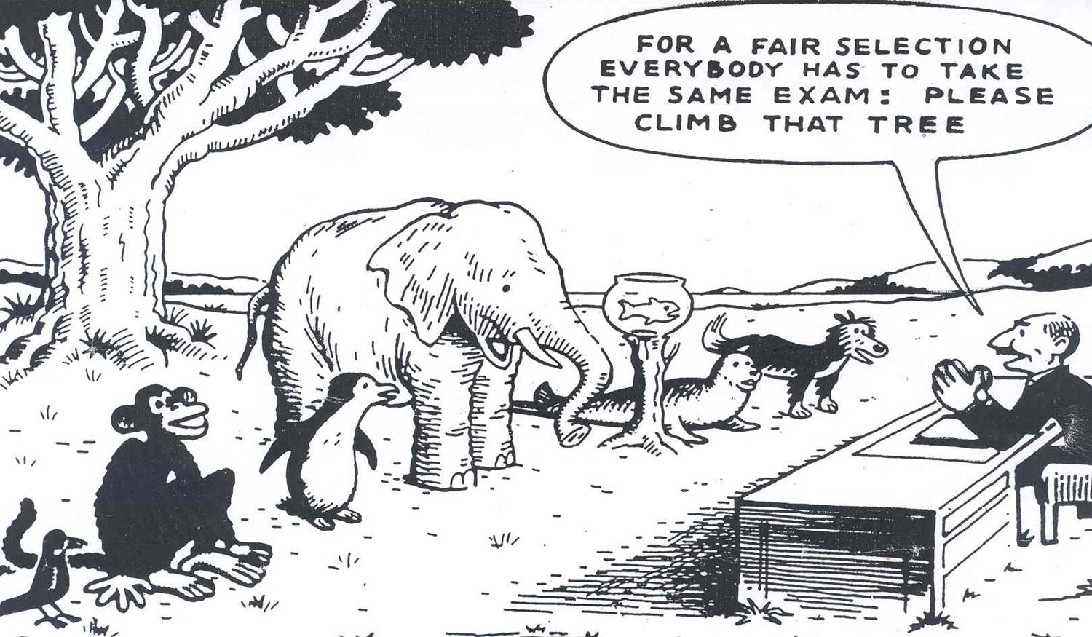
Universal Design for Learning
UDL works from the recognition that the ways in which students acquire knowledge best and express what they know effectively, can be very different from student to student. Instructors can consider presenting material through a range of mediums, providing various options for expressing and assessing student knowledge and understanding, to various approaches to promote student engagement and motivation.
Notes:
Researchers determined that when principles of universal design were applied to the learning environment, it improved opportunities for learning for all students. A course designed using UDL principles is more flexible and student-centred, enabling the students to make choices or be more involved in the learning process by providing multiple ways to access content and express their learning.

Slide 17
Benefits of UDL:
1. Reduces or eliminates the need for individual accommodations
When a variety of options are provided for all students, it can help to reduce time and effort by instructors and students in making these special arrangements
2. Can help focus attention on concrete and specific course outcomes
In order to provide increased flexibility in both course delivery, supports, and assessment, it is critical that instructors have a very clear understanding of the essential learning outcomes and objectives of their course
3. Takes into account many types of diversity, not only differences related to a disability
Many other students also have characteristics that fall outside of what may be considered as the norm in the classroom. These could include:
students with English as a second language or from different cultural backgrounds,
students with varied educational histories, and
students with a range of learning styles, strengths and weaknesses.
Notes:
Provides increased flexibility & options for all students
Using this approach, instructors do not consider that all students learn in the same way. Instead they consider that their students will have a variety of learning styles, strengths and weaknesses, and personal characteristics, that will influence how they take in knowledge, use it, and express it. In recognizing this, instructors:
present their materials using a variety of methods, both for teaching and course materials consider how the classroom setting will be experienced by different students, and
provide a variety of options for learning supports and for assessment (assignments and tests).
1. Reduces or eliminates the need for individual accommodations
This can mean that students with disabilities will have a greater ability to participate in the course in the same way as all other students, and can help to reduce time and effort by instructors and students in making individual accommodation arrangements. For example, if all students are provided with options for both a take home exam and a timed test, students with disabilities may find that the take-home exam eliminates their need for a separate testing setting to obtain more time. If instructors provide videotapes of their lectures and copies of lecture notes for all students, it could eliminate the need for students with disabilities to digitally record their lectures or to request a note-taker.
2. Can help focus attention on concrete and specific course outcomes
UDL also provides instructors with a strong impetus to clearly identify the skills students are expected to master and the knowledge that is critical. Clear course outcomes will greatly help instructors to determine what options for assessment will not interfere with these, and what methods of delivery and student engagement will be a good fit for the type of knowledge they are presenting and the skills they are working to develop in students.
3. Takes into account many types of diversity, not only differences related to a disability

Slide 18
An example of UDL in practice
In this video Professor Doug Campbell describes how he moved to reflecting principles of Universal Design for assessing student learning in his classes. He now provides a variety of assessment options to all students in his class.
https://www.youtube.com/watch?v=-hNrdtfchc8 (4:21)
Notes:
Post-Video Reflection Questions
What do you see as the potential benefits and drawbacks to designing your course for universal accessibility?
At this point, do you see more benefits to the individual accommodations approach, or to Universal Design? Why?

Slide 19
Implementing Universal Design for Learning
For over a decade, increasing attention has been paid to how ideas of Universal Design for Learning (UDL) can be implemented in practical terms in the classroom. Building from this research and experience, we will consider:
the important role of empathy in using UDL as an approach to teaching and learning
the importance of clear course goals and outcomes in implementation of UDL
3 Principles to guide implementation of UDL
Notes:
Each of these three points will be broken down in the following slides.

Slide 20
Importance of Empathy
Empathy refers to the act of trying to understand another person’s perspective or experience. It involves considering what it would be like to be in another person’s place, or in a sense, to be another person.
instructor’s interactions with students and their attitude towards their diverse needs, was more impactful to students than any other accommodation or support.
When students felt that their instructors were:
approachable,
viewed accommodation as a regular part of classroom practice, and
viewed student learning and success as a central focus in this regard,
students were more likely to seek support, and to feel a part of the classroom community.
Video of instructor modeling Empathy and Understanding in working with diverse students.
As you watch this video, consider what climate this likely created in her class.
http://www2.unb.ca/alc/modules/learning-disabilities/video.html (8:22)
Notes:
Empathy is different from sympathy. Sympathy refers to when a person considers how they would feel if they themselves had the characteristics or circumstances of another person, while empathy seeks to understand another person’s perspective from that other person’s viewpoint. The distinction between these two approaches is important because empathy seeks to understand someone else’s reality and reactions. It does not assume that the other person will behave or feel as we ourselves would in the same circumstances. Being empathetic requires active listening for, and consideration of another person’s perspective or reality. Empathy is a strong vehicle for building understanding and for demonstrating respect for others who have differences from us.
Classroom climate has a strong impact on the experience of diverse learners. Increasing diversity is a reality in most classrooms today. Differences in ability, learning styles, educational and cultural backgrounds, among other factors, mean that it is even more important for faculty to get to know their students. By doing so, they are able to understand better how they learn, when they are experiencing challenges, and what solutions may work for them.
Orr’s (2009) research found several examples of approaches that students’ reported helped demonstrate an empathetic, understanding, approachable, and respectful attitude towards diversity. Some of these examples include:
providing a variety of means to consult with instructors such as both on-line and in person office hours
instructors’ invitation to students to talk with them about any learning challenges and issues early in the course
holding high expectations for all students including those with disabilities
approaching accommodation needs and assistive technology in the classroom with a cooperative collaborative approach
The attached video demonstrates empathy as a foundation for teaching diverse students promotes a successful learning experience for students, and also provides instructors with the ability to develop understanding and build knowledge on how to respond effectively to diverse learning needs.

Slide 21
Clear Course Goals:
A necessity in supporting the 3 principles of UDL
Before working to apply the principles of UDL in your classroom, it is essential that you have a clear and concrete understanding of your course goals.
What are the essential learning outcomes of your course?
What skills and competencies will students be required to demonstrate at the end of the course? What knowledge will they be required to have in their heads?
What knowledge will they be required to know how to access?
Notes:
A clear understanding of your goals will help you to decide what ways of presenting your content will be useful, what learning activities and supports would be helpful in supporting students to apply this knowledge, and what ways you will use to develop and maintain their interest and motivation in the course. As you work forward from these course goals, keep in mind what you know about the range of learners that will likely be in your class and the importance of providing multiple approaches to respond to this diversity.

Slide 22
Three Principles to Guide Implementation of UDL
UDL suggests that instructors focus on planning around how they:
Represent course content,
Opportunities for student expression of their learning
Student engagement with their learning
*The Centre for Applied Science and Technology (CAST)
Notes:
The Centre for Applied Science and Technology (CAST) has developed three principles to guide the implementation of UDL. They suggest that instructors focus on planning around how they:
Represent course content,
Opportunities for student expression of their learning
Student engagement with their learning
Implementing UDL Principles:
Download the CAST UDL Guidelines infographic <hyperlink to http://www.udlcenter.org/sites/udlcenter.org/files/updateguidelines2_0.pdf>
Three Principles of UDL
These three principles are summarized in the next slides along with examples in the facilitator notes of how they were implemented in an actual course (Rose, 2006).
The course website contains link to pdf file summarizing Rose’s findings. Download here:
https://sswdcourse.jibc.ca/wp-content/uploads/2016/03/Three-Principles-of-UDL.pdf
You may wish to consider providing both the CAST infographic and pdf for participants as a handout for use in the workshop discussions.

Slide 23
Principle 1:
Multiple Means of Representation
This principle puts forward that no one means of representing knowledge or one mode for transferring that knowledge will work for all students. As a result, presenting course content using more than one approach can be very helpful.
Notes:
Example in Practice
consider how students access information in your course and whether they are able to use this information effectively to learn
consider teaching practices in the course; are these practices effective and fully accessible to all students?
Suggested Considerations
Provided choice of two textbooks, one more graphically based another more based on prose. Students could pick which ever worked best for them.
Videotaped all lectures and posted the full lecture on the course website for later viewing
Required that all students in the class take turns providing copies of their notes to their classmates for reference. These notes were posted on the class website for all to view
Worked to ensure that lectures were conducted in structured ways that reduced cognitive load and highlighted main ideas
Supported lectures with powerpoint slides that highlighted key concepts in alternate ways. These slides were also posted to the class website
Introduced case studies in discussion groups to help make content learned in class meaningful to students

Slide 24
Principle 2:
Multiple Means of Expression
This principle puts forward that no one means of supporting student learning and expression will work for all, again providing several alternatives is essential.
Notes:
Example in Practice
Consider providing students with options around how they demonstrate their knowledge and understanding of course content
Consider providing a range of alternative tools or ways to support student learning in your class
Suggested Considerations
Student contributions to class notes allowed students to demonstrate their understanding of lectures in their own unique ways and affirmed their ways of representing content (some provided detailed outlines, others provided graphical representations, etc) Students learned from each other as well through this process
A range of options for discussion groups were provided to support learning; both in terms of content (focused on review, or advanced to extend knowledge), and by venue (either in person or online). Students were able to choose whether these opportunities would be helpful to them, and if so, which they wished to participate in.
Assessment through assignments focused on students’ ability to apply their knowledge. Students were required to present their approach as a website involving both written, graphical, and design components. Students were encourage to support each other in areas they were strong in.

Slide 25
Principle 3:
Multiple Means of Engagement
Students can be very different in “the ways in which they are engaged or motivated to learn.
some students are highly engaged by spontaneity and novelty (e.g., stu­dents with ADD/ADHD)
others are disengaged or even frightened by those aspects in a learning environ­ment (e.g., students with Asperger’s Syndrome or autism).
some students are engaged by risk and chal­lenge in a learning environment
others seek safety and support.
Some are attracted to dynamic social forms of learning,
others shy away and recede from social forms.
There is no one way of engaging students that will work best for all.”(Rose, 2006)
Notes:
Suggested Considerations
Consider providing several ways for students to apply what they are learning
take into account that students can have very different emotional and attitudinal backgrounds and dispositions around learning
Examples in Practice
provided different approaches to class discussions. They found that students with English as a second language were attracted to the online discussion forums while students with dyslexia tended to attend the face-to-face discussion groups more often.
the sharing of note-taking responsibilities and the sharing of these notes also allowed some students to have their first experience of seeing the value of their approaches. For example, some students with learning disabilities had believed that they were not capable of taking good notes, but after seeing the variety of note taking styles in their class and that their notes were also valuable to others, their belief changed.
By asking students to share their work and collaborate around their strengths and weaknesses on assignments, a climate was created where students learned from one another, applied this knowledge, and had the opportunity to see their skills and the results of their work valued by their peers.
the course website also provided access to additional resources and links that further explained course topics. This provided opportunities for students who are accustomed to accessing additional sources to cement their knowledge, to further engage with their learning and the course.

Slide 26
How could the Principles of UDL
be Applied?
Pick a course you are currently teaching, describe the specific goals or essential learning outcomes for this course.
Consider what you know about the range of learning styles, abilities, and educational backgrounds of students who typically take this course. Provide a summary of these below.
Now consider the two summaries you created with respect to each of the Principles of UDL described above. Note down some ideas of practices you are currently using, or new practices that you may consider adopting to implement each of these principles in your class.
Consider and note down how you get to know your students and let them know you are open to their experience, learning needs, and feedback.
Notes:
Consider participants in the workshop, and decide on an appropriate approach for the exercise below. It may be most useful to group participants that teach similar areas together, or you may consider asking participants to work individually and then share their ideas at the end. You could also provide participants with the opportunity to complete the exercise using the approach most useful to them.
After completing this exercise, reflect and share thoughts around implementing UDL Principles in your classroom. Would this be realistic? What supports would you need to do this? What challenges would you face?

Slide 27
Thank you very much for your time and feedback
Martin Keyserlingk
Myriam Spencer
Notes:
Comments? Thoughts? Feedback? on these tools and your experience today using them?

